Slide 1
ENDOCRINE DISORDERS
ANNE OBUOYO

Slide 2
PITUITARY DISORDERS

Slide 3
DIABETES INSIPIDUS

Slide 4
Introduction
Diabetes insipidus (DI) is a disorder resulting from deficiency of anti-diuretic hormone (ADH) or its action and is characterized by the passage of copious amounts of dilute urine.
It must be differentiated from other polyuric states such as primary polydipsia & osmotic diuresis. Central DI is due to failure of the pituitary gland to secrete adequate ADH.

Slide 5
Cont’d
Nephrogenic DI results when the renal tubules of the kidneys fail to respond to circulating ADH.
The resulting renal concentration defect leads to the loss of large volumes of dilute urine. This causes cellular and extracellular dehydration and hypernatremia.

Slide 6
Causes
It may be secondary to head trauma, brain tumor, or surgical ablation or irradiation of the pituitary gland.
It may also occur with infections of the central nervous system (meningitis, encephalitis, tuberculosis) or tumors (e.g. metastatic disease, lymphoma of the breast or lung).
Another cause of diabetes insipidus is failure of the renal tubules to respond to ADH; this nephrogenic form may be related to hypokalemia, hypercalcemia, and a variety of medications (e.g. lithium, demeclocycline [Declomycin]).

Slide 7
Causes of Central DI
Idiopathic (30% of cases).
Suprasellar tumours (30% of cases).
Infections (encephalitis, TB, etc)
Non-infectious granuloma (sarcoid, hand-schuller christian disease.
Trauma or skull surgery
Leukemia.

Slide 8
Cont’d
Autoimmune associated with thyroiditis.
Familial: 2 types ad & x-linked inheritance.
Wolfram syndrome (also known as didmoad syndrome) characterized by DI, DM, nerve deafness and optic atrophy.

Slide 9
Causes of Nephrogenic DI
Primary familial: X-linked recessive that is severe in boys & mild in girls
Secondary to:
Chronic pyelonephritis
Hypokalemia
Hypercalcemia
Sickle cell disease
Protein deprivation

Slide 10
Secondary Causes cont’d
Amyloidosis
Other renal diseases (chronic renal failure, obstructive uropathy, polycystic disease).
Drugs (lithium, colchicine, fluoride, cidofovir, demeclocycline, methoyflurane).

Slide 11
Clinical Manifestations
Without the action of ADH on the distal nephron of the kidney, an enormous daily output of very dilute, water-like urine with a specific gravity of 1.001 to 1.005 occurs. The urine contains no abnormal substances such as glucose and albumin. Because of the intense thirst, the patient tends to drink 2 to 20 liters of fluid daily and craves cold water.
In the hereditary form of diabetes insipidus, the primary symptoms may begin at birth. In adults, the onset of diabetes insipidus may be abrupt or insidious. The disease cannot be controlled by limiting fluid intake because the high-volume loss of urine continues even without fluid replacement. Attempts to restrict fluids cause the patient to experience an insatiable craving for fluid and to develop hypernatremia and severe dehydration.

Slide 12
Diagnosis
The fluid deprivation test is carried out by withholding fluids for 8 to 12 hours or until 3% to 5% of the body weight is lost. The patient is weighed frequently during the test. Plasma and urine osmolality studies are performed at the beginning and end of the test. The inability to increase the specific gravity and osmolality of the urine is characteristic of diabetes insipidus.
The patient continues to excrete large volumes of urine with low specific gravity and experiences weight loss, rising serum osmolality, and elevated serum sodium levels. The patient’s condition needs to be monitored frequently during the test, and the test is terminated if tachycardia, excessive weight loss, or hypotension develops.

Slide 13
Cont’d
Concurrent measurements of plasma levels of ADH (vasopressin) and plasma and urine osmolality.
A trial of desmopressin (synthetic vasopressin) therapy and intravenous infusion of hypertonic saline solution.
When the diagnosis is confirmed and the cause is not obvious (e.g. head injury), the patient is carefully assessed for tumors that may be causing the disorder.

Slide 14
Medical Management
The objectives of therapy are:
(1) To replace ADH (which is usually a long-term therapeutic program).
(2) To ensure adequate fluid replacement.
(3) To identify and correct the underlying intracranial pathology.
Nephrogenic causes require different management approaches.

Slide 15
Pharmacologic Therapy
Desmopressin (DDAVP), a synthetic vasopressin without the vascular effects of natural ADH. One or two administrations daily or every 12 to 24 hours usually control the symptoms.
Another form of therapy is the intramuscular administration of ADH, or vasopressin tannate in oil, which is used when the intranasal route is not possible. It is administered every 24 to 96 hours. The vial of medication should be warmed or shaken vigorously before administration. The injection is administered in the evening so that maximum results are obtained during sleep.
If the diabetes insipidus is renal in origin, the previously described treatments are ineffective. Thiazide diuretics, mild salt depletion, and prostaglandin inhibitors (ibuprofen, indomethacin, and aspirin) are used to treat the nephrogenic form of diabetes insipidus.

Slide 16
Nursing Management
The patient with possible diabetes insipidus needs encouragement and support while undergoing studies for a possible cranial lesion.
Administer prescribed drugs. Vasopressin must be administered with caution if the patient has coronary artery disease because the medication causes vasoconstriction.
The nurse needs to inform the patient and family about follow-up care and emergency measures. The nurse also needs to provide specific verbal and written instructions, show the patient how to administer the medications, and observe return demonstrations as appropriate. The nurse also advises the patient to wear a medical identification bracelet and to carry medication and information about this disorder at all times.

Slide 17
Complications
Hypernatremic dehydration & its neurological sequelea.
Growth retardation.
Hydronephrosis (due to excessive urine output).

Slide 18
ADRENAL DISORDERS

Slide 19
ADRENOCORTICAL INSUFFICIENCY (ADDISON’S DISEASE)

Slide 20
Introduction
Addison’s disease, or adrenocortical insufficiency, results when adrenal cortex function is inadequate to meet the patient’s need for cortical hormones.
It’s an endocrine or hormonal disorder that occurs due to the destruction or dysfunction of the entire adrenal glands.

Slide 21
Causes
Autoimmune or idiopathic atrophy of the adrenal glands is responsible for 80% of cases.
Other causes include surgical removal of both adrenal glands or infection of the adrenal glands.
Tuberculosis and histoplasmosis are the most common infections that destroy adrenal gland tissue.
Inadequate secretion of ACTH from the pituitary gland also results in adrenal insufficiency because of decreased stimulation of the adrenal cortex.
Therapeutic use of corticosteroids is the most common cause of adrenocortical insufficiency.

Slide 22
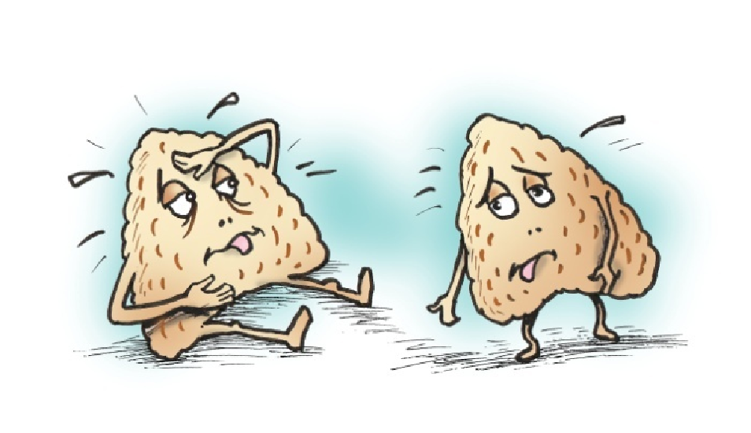
Cont’d
Primary
Idiopathic
Autoimmune (The immune system mistakenly attacking the gland).
Adrenalectomy
Tumors
Infections

Slide 23
Cont’d
Secondary
Decrease secretion of ACTH
Pituitary neoplasm

Slide 24
Clinical Manifestations
Addison’s disease is characterized by muscle weakness, anorexia, gastrointestinal symptoms, fatigue, emaciation, dark pigmentation of the skin, knuckles, knees, elbows, and mucous membranes, hypotension, and low blood glucose levels, low serum sodium levels, and high serum potassium levels.
Mental status changes such as depression, emotional lability, apathy, and confusion are present in 60% to 80% of patients.
In severe cases, the disturbance of sodium and potassium metabolism may be marked by depletion of sodium and water and severe, chronic dehydration.

Slide 25
Cont’d
With disease progression and acute hypotension, the patient develops addisonian crisis, which is characterized by cyanosis and the classic signs of circulatory shock: pallor, apprehension, rapid and weak pulse, rapid respirations, and low blood pressure.
In addition, the patient may complain of headache, nausea, abdominal pain, and diarrhea and show signs of confusion and restlessness. Even slight overexertion, exposure to cold, acute infections, or a decrease in salt intake may lead to circulatory collapse, shock, and death if untreated.
The stress of surgery or dehydration resulting from preparation for diagnostic tests or surgery may precipitate an addisonian or hypotensive crisis.

Slide 26
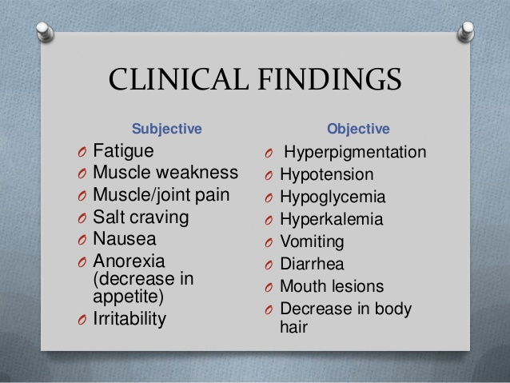
Clinical Findings

Slide 27
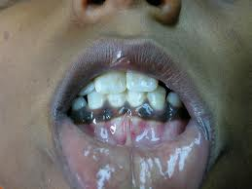
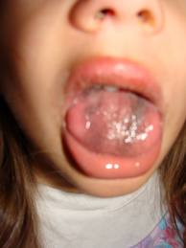
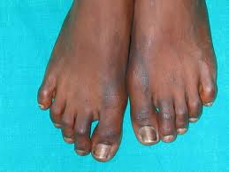
Addison’s Pictures

Slide 28
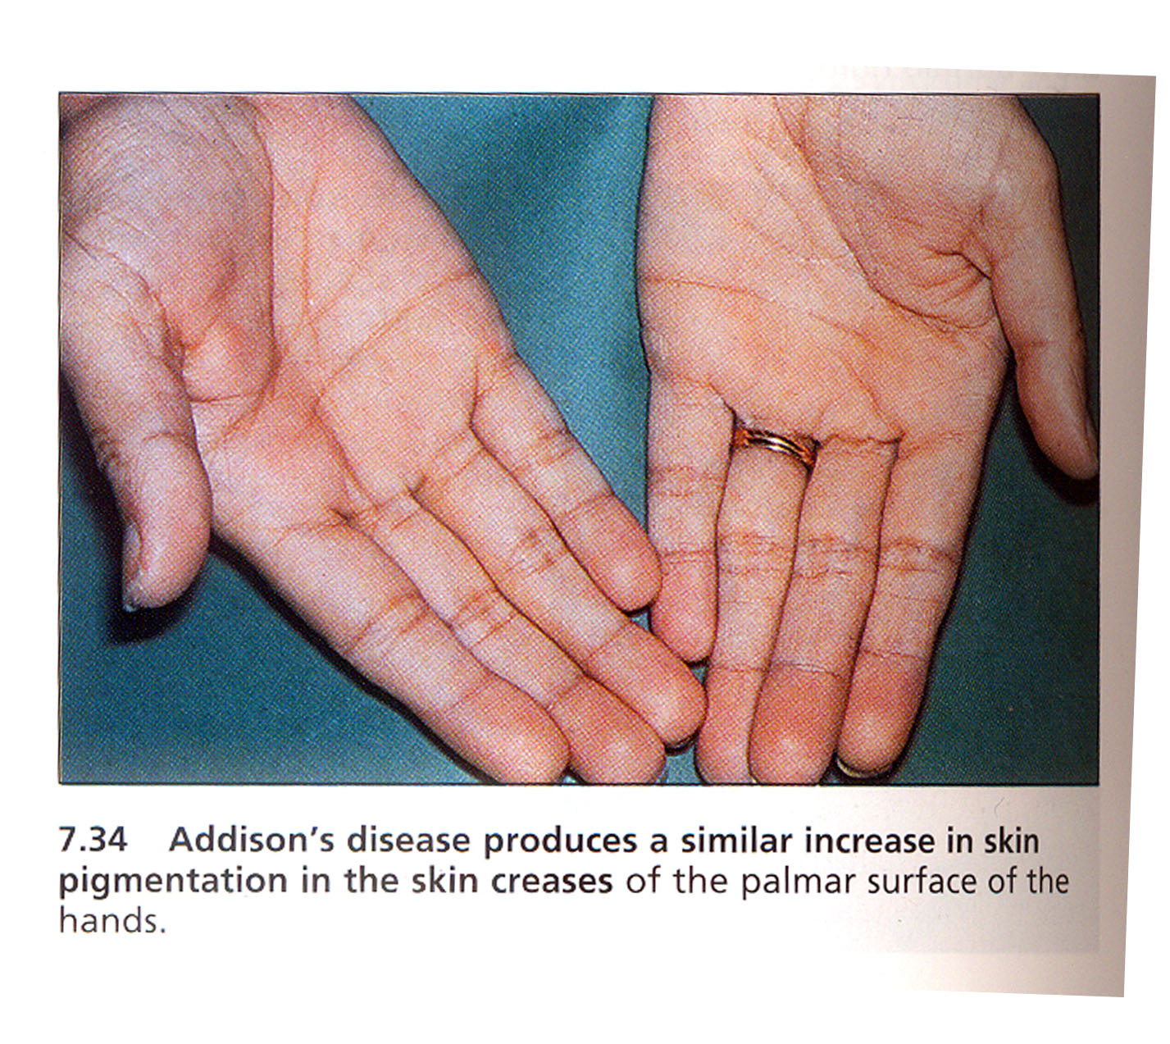

Slide 29
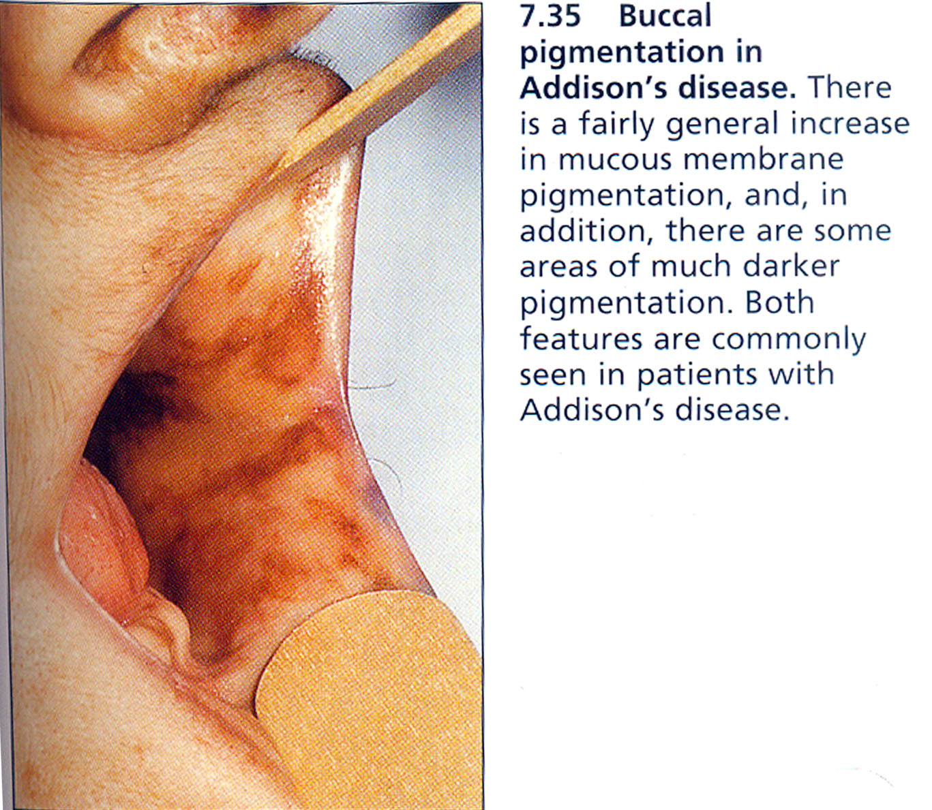

Slide 30
Diagnosis
The diagnosis is confirmed by laboratory test results. Laboratory findings include decreased blood glucose (hypoglycemia) and sodium (hyponatremia) levels, an increased serum potassium (hyperkalemia) level, and an increased white blood cell count (leukocytosis).
The diagnosis is confirmed by low levels of adrenocortical hormones in the blood or urine and decreased serum cortisol levels.
Imaging:
Usually in the form of ultrasound, computed tomography or magnetic resonance imaging (MRI).

Slide 31
Medical Management
Immediate treatment is directed toward combating circulatory shock: Restoring blood circulation, administering fluids and corticosteroids, monitoring vital signs, and placing the patient in a recumbent position with the legs elevated.
Hydrocortisone is administered intravenously, followed with 5% dextrose in normal saline. Vasopressor amines may be required if hypotension persists.
Antibiotics may be administered if infection has precipitated adrenal crisis in a patient with chronic adrenal insufficiency. Additionally, the patient is assessed closely to identify other factors, stressors, or illnesses that led to the acute episode.

Slide 32
Cont’d
Oral intake may be initiated as soon as tolerated. Gradually, intravenous fluids are decreased when oral fluid intake is adequate to prevent hypovolemia. If the adrenal gland does not regain function, the patient needs lifelong replacement of corticosteroids and mineralocorticoids to prevent recurrence of adrenal insufficiency.
The patient will require additional supplementary therapy with glucocorticoids during stressful procedures or significant illnesses to prevent addisonian crisis.
Additionally, the patient may need to supplement dietary intake with added salt during times of gastrointestinal losses of fluids through vomiting and diarrhea.

Slide 33
Nursing Management
Nursing diagnoses
Electrolyte imbalance r/t nausea and vomiting as evidenced by hyperkalemia and hyponatremia.
Imbalanced nutrition: less than body requirements r/t anorexia as evidenced by decrease in weight and inadequate food intake.

Slide 34
Cont’d
Assess the patient.
The health history and examination focus on the presence of symptoms of fluid imbalance and on the patient’s level of stress.
To detect inadequate fluid volume, the nurse monitors the blood pressure and pulse rate as the patient moves from a lying to a standing position. The nurse assesses the skin color and turgor for changes related to chronic adrenal insufficiency and hypovolemia.
Other key assessments include checking for weight changes, muscle weakness, and fatigue and investigating any illness or stress that may have precipitated the acute crisis.

Slide 35
Cont’d
Monitor and manage addisonian crisis.
The patient at risk is monitored for signs and symptoms indicative of addisonian crisis. These symptoms are often the manifestations of shock: hypotension; rapid, weak pulse; rapid respiratory rate; pallor; and extreme weakness. The patient with addisonian crisis is at risk for circulatory collapse and shock; therefore, physical and psychological stressors must be avoided. These include exposure to cold, overexertion, infection, and emotional distress.
The patient with addisonian crisis requires immediate treatment with intravenous administration of fluid, glucose, and electrolytes, especially sodium; replacement of missing steroid hormones; and vasopressors. During acute addisonian crisis, the patient must avoid exertion; therefore, the nurse anticipates the patient’s needs and takes measures to meet them.

Slide 36
Cont’d
Restore fluid balance.
To provide information about fluid balance and the adequacy of hormone replacement, the nurse assesses the patient’s skin turgor, mucous membranes, and weight while instructing the patient to report increased thirst, which may indicate impending fluid imbalance. Lying, sitting, and standing blood pressures also provide information about fluid status. A decrease in systolic pressure (20 mm Hg or more) may indicate depletion of fluid volume, especially if accompanied by symptoms.
The nurse encourages the patient to consume foods and fluids that will assist in restoring and maintaining fluid and electrolyte balance; along with the dietitian, the nurse assists the patient to select foods high in sodium during gastrointestinal disturbances and very hot weather.

Slide 37
Cont’d
Improve activity tolerance.
Until the patient’s condition is stabilized, the nurse takes precautions to avoid unnecessary activity and stress that could precipitate another hypotensive episode. Efforts are made to detect signs of infection or the presence of other stressors. Even minor events or stressors may be excessive in patients with adrenal insufficiency.
During the acute crisis, the nurse maintains a quiet, nonstressful environment and performs all activities (e.g. bathing, turning) for the patient. Explaining all procedures to the patient and family will reduce their anxiety. Explaining the rationale for minimizing stress during the acute crisis assists the patient to increase activity gradually.

Slide 38
Cont’d
Perform patient teaching.
The nurse instructs the patient and family to administer hormone replacement as prescribed and to modify the medication dosage and increase salt intake in times of illness, very hot weather, and other stressful situations. The patient also learns how to modify diet and fluid intake to help maintain fluid and electrolyte balance.
Written and verbal instructions are provided about the administration of mineralocorticoid (Florinef) or corticosteroid (prednisone) as prescribed.

Slide 39
Complications
1. Addisonian crisis - characterized by cyanosis and signs of circulatory shock:
Pallor
Rapid and weak pulse
Rapid respirations
Low blood pressure
Severe vomiting and diarrhea
Lethargy
Hypercalcemia
2. Shock
3. Coma – death.

Slide 40
CUSHING’S SYNDROME

Slide 41
Introduction
Cushing’s syndrome results from excessive, rather than deficient, adrenocortical activity.
The syndrome may result from excessive administration of corticosteroids or ACTH or from hyperplasia of the adrenal cortex.

Slide 42
Pathophysiology
Cushing’s syndrome is commonly caused by use of corticosteroid medications and is infrequently due to excessive corticosteroid production by the adrenal cortex. However, overproduction of endogenous corticosteroids may be caused by several mechanisms, including a tumor of the pituitary gland that produces ACTH and stimulates the adrenal cortex to increase its hormone secretion despite adequate amounts being produced.

Slide 43
Cont’d
Primary hyperplasia of the adrenal glands in the absence of a pituitary tumor is less common. Another less common cause of Cushing’s syndrome is the ectopic production of ACTH by malignancies; bronchogenic carcinoma is the most common type of these malignancies.
Regardless of the cause, the normal feedback mechanisms that control the function of the adrenal cortex become ineffective, and the usual diurnal pattern of cortisol is lost.
The signs and symptoms of Cushing’s syndrome are primarily a result of oversecretion of glucocorticoids and androgens (sex hormones), although mineralocorticoid secretion also may be affected.

Slide 44
Clinical Manifestations
When overproduction of the adrenal cortical hormone occurs, arrest of growth, obesity, and musculoskeletal changes occur along with glucose intolerance.
The classic picture of Cushing’s syndrome in the adult is that of central-type obesity, with a fatty “buffalo hump” in the neck and supraclavicular areas, a heavy trunk, and relatively thin extremities.
The skin is thin, fragile, and easily traumatized; ecchymoses (bruises) and striae develop.
The patient complains of weakness and lassitude. Sleep is disturbed because of altered diurnal secretion of cortisol.
There is increased susceptibility to infection.

Slide 45
Cont’d
Excessive protein catabolism occurs, producing muscle wasting and osteoporosis. Kyphosis, backache, and compression fractures of the vertebrae may result.
Retention of sodium and water occurs as a result of increased mineralocorticoid activity, producing hypertension and heart failure.
The patient develops a “moon-faced” appearance and may experience increased oiliness of the skin and acne.
Hyperglycemia or overt diabetes may develop.
The patient may also report weight gain, slow healing of minor cuts, and bruises.

Slide 46
Diagnosis
Indicators of Cushing’s syndrome include an increase in serum sodium and blood glucose levels and a decreased serum concentration of potassium, a reduction in the number of blood eosinophils, and disappearance of lymphoid tissue.
Measurements of plasma and urinary cortisol levels are obtained.

Slide 47
Cont’d
Measurement of plasma ACTH by radioimmunoassay is used in conjunction with the high-dose suppression test to distinguish pituitary tumors from ectopic sites of ACTH production. Elevation of both ACTH and cortisol level indicates pituitary or hypothalamic disease. Low ACTH with a high cortisol level indicates adrenal disease.
A CT scan, ultrasound, or MRI may be performed to localize adrenal tissue and detect tumors of the adrenal gland.

Slide 48
Medical Management
Purpose:
Correct metabolic abnormalities before attempted surgical cure.
Palliate surgically noncurable disease.
Achieve remission in patients for whom surgery is unlikely to achieve satisfactory long term results.

Slide 49
Cont’d
If Cushing’s syndrome is caused by pituitary tumors rather than tumors of the adrenal cortex, treatment is directed at the pituitary gland. Surgical removal of the tumor by transsphenoidal hypophysectomy is the treatment of choice and has a 90% success rate.
Radiation of the pituitary gland also has been successful, although it may take several months for control of symptoms. Adrenalectomy is the treatment of choice in patients with primary adrenal hypertrophy.

Slide 50
Cont’d
Postoperatively, symptoms of adrenal insufficiency may begin to appear 12 to 48 hours after surgery because of reduction of the high levels of circulating adrenal hormones. Temporary replacement therapy with hydrocortisone may be necessary for several months until the adrenal glands begin to respond normally to the body’s needs.
If both adrenal glands have been removed (bilateral adrenalectomy), lifetime replacement of adrenal cortex hormones is necessary.

Slide 51
Nursing Management
Possible Nursing Diagnoses
Risk for injury related to weakness.
Risk for infection related to altered protein metabolism and inflammatory response.
Self-care deficit related to weakness, fatigue, muscle wasting, and altered sleep patterns.
Impaired skin integrity related to edema, impaired healing, and thin and fragile skin
Disturbed body image related to altered physical appearance, impaired sexual functioning, and decreased activity level
Disturbed thought processes related to mood swings, irritability, and depression.

Slide 52
Cont’d
Take history and perform physical examination.
The health history and examination focus on the effects on the body of high concentrations of adrenal cortex hormones and on the inability of the adrenal cortex to respond to changes in cortisol and aldosterone levels.
Decrease risk for injury.
Establishing a protective environment will help to prevent falls, fractures, and other injuries to bones and soft tissues.

Slide 53
Cont’d
Decrease risk for infection.
The patient should avoid unnecessary exposure to others with infections. The nurse frequently assesses the patient for subtle signs of infection because the anti-inflammatory effects of corticosteroids may mask the common signs of inflammation and infection.
Promote skin integrity
Meticulous skin care is necessary to avoid traumatizing the patient’s fragile skin. Use of adhesive tape is avoided because it can irritate the skin and tear the fragile tissue when the tape is removed. The nurse frequently assesses the skin and bony prominences and encourages and assists the patient to change positions frequently to prevent skin breakdown.

Slide 54
Cont’d
Prepare the patient for surgery.
The patient is prepared for adrenalectomy, if indicated, and the postoperative course. If Cushing’s syndrome is a result of a pituitary tumor, a transsphenoidal hypophysectomy may be performed.
Before, during, and after surgery, blood glucose monitoring and assessment of stools for blood are carried out to monitor for appropriate intervention.
If the patient has other symptoms of Cushing’s syndrome, these are considered in the preoperative preparation. For example, if the patient has experienced weight gain, special instruction is given about postoperative breathing exercises.

Slide 55
Cont’d
Encourage rest and activity.
Weakness, fatigue, and muscle wasting make it difficult for the patient with Cushing’s syndrome to carry out normal activities. The nurse should encourage moderate activity to prevent complications of immobility and promote increased self-esteem. Insomnia often contributes to the patient’s fatigue. It is important to help the patient plan and space rest periods throughout the day. Efforts are made to promote a relaxing, quiet environment for rest and sleep.

Slide 56
Cont’d
Improve body image.
If the cause of Cushing’s syndrome can be treated successfully, the major physical changes disappear in time. The patient may benefit from discussion of the effect the changes have had on his or her self-concept and relationships with others. Weight gain and edema may be modified by a low-carbohydrate, low-sodium diet, and a high-protein intake may reduce some of the other bothersome symptoms.

Slide 57
Cont’d
Improve thought processes.
Explanations to the patient and family members about the cause of emotional instability are important in helping them cope with the mood swings, irritability, and depression that may occur. Psychotic behavior may occur in a few patients and should be reported. The nurse encourages the patient and family members to verbalize their feelings and concerns.
Perform patient teaching on disease process and management.

Slide 58
Cont’d
Monitor and manage potential complications.
a. Addisonian Crisis
The patient with Cushing’s syndrome whose symptoms are treated by withdrawing corticosteroids, by adrenalectomy, or by removing a pituitary tumor is at risk for adrenal hypofunction and addisonian crisis.
The patient is monitored closely for hypotension; rapid, weak pulse; rapid respiratory rate; pallor; and extreme weakness. Efforts are made to identify factors that may have led to the crisis.
The patient may require intravenous administration of fluid and electrolytes and corticosteroids before, during, and after treatment or surgery. If addisonian crisis occurs, the patient is treated for circulatory collapse and shock.

Slide 59
Cont’d
b. Adverse Effects of Adrenocortical Activity
The nurse assesses fluid and electrolyte status by monitoring laboratory values and daily weights. Because of the increased risk for glucose intolerance and hyperglycemia, blood glucose monitoring is initiated. The nurse reports elevated blood glucose levels to the physician so that treatment can be prescribed if indicated.

Slide 60
Complications
Addisonian crisis.
Adverse effects of adrenocortical activity.

Slide 61


